Slide 1
IIT Bombay
Page 1
Course Code : EE 611
Department: Electrical Engineering
Instructor Name: Jayanta Mukherjee
Email: jayanta@ee.iitb.ac.in
Lecture 4
EE 611 Lecture 4 Jayanta Mukherjee

Slide 2
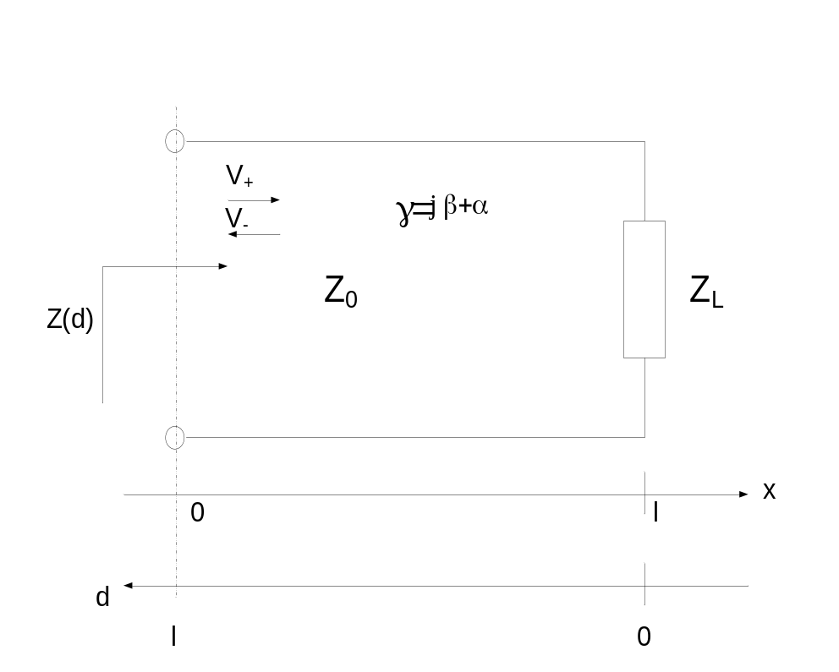
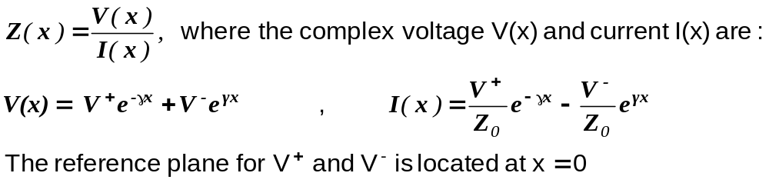
IIT Bombay
Page 2
Impedance of Loaded Transmission Lines
The impedance along a transmission line at position x is given by
EE 611 Lecture 1
EE 611 Jayanta Mukherjee Lecture 1
EE 611 Lecture 4 Jayanta Mukherjee

Slide 3
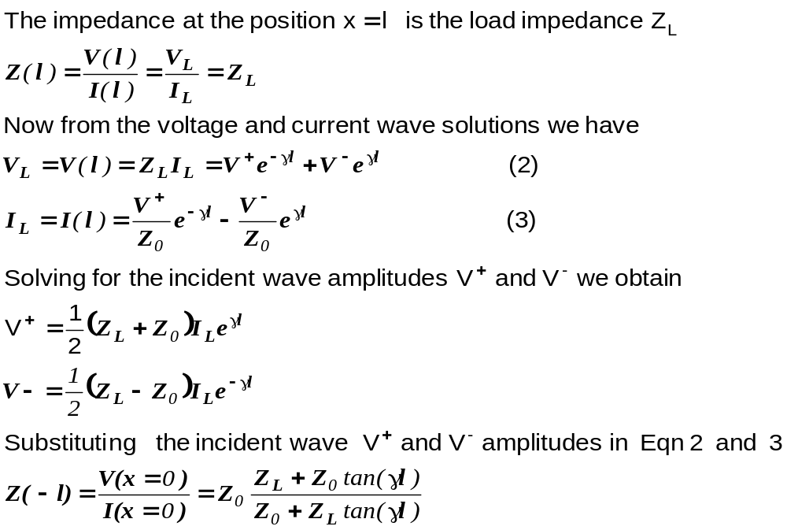
IIT Bombay
Page 3
Impedance Calculation
EE 611 Lecture 1
EE 611 Jayanta Mukherjee Lecture 1
EE 611 Lecture 4 Jayanta Mukherjee

Slide 4
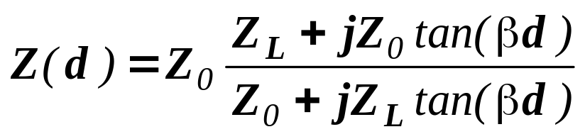
IIT Bombay
Page 4
Lossless Case
For a loss free line we have γ=jβ and the impedance reduces to:
The impedance Z is then periodic function of frequency and
position:
In terms of the electrical angle θ=βd the impedance Z repeats
every period π
In terms of position d it repeats every half wavelength λ/2 since
we have βd=(2π/λ)d
EE 611 Lecture 1
EE 611 Jayanta Mukherjee Lecture 1
EE 611 Lecture 4 Jayanta Mukherjee

Slide 5
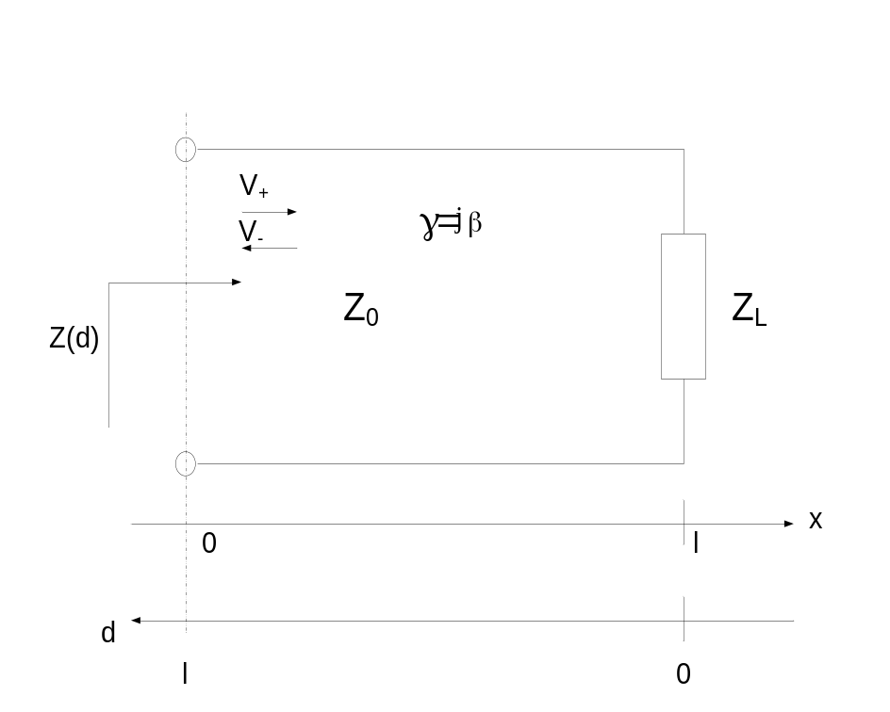
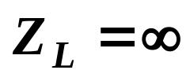
IIT Bombay
Page 5
Impedance of a Shorted Transmission Line
For a short circuited line, Z_{L}=0 and we have Z(d)=jZ₀tan(βd)
For an open circuited line, and we have Z(d)=-jZ₀cot(βd)
For a matched load, Z_{L}=Z₀, and we have Z(d)=Z₀ for all values
of d
EE 611 Lecture 1
EE 611 Jayanta Mukherjee Lecture 1
EE 611 Lecture 4 Jayanta Mukherjee

Slide 6
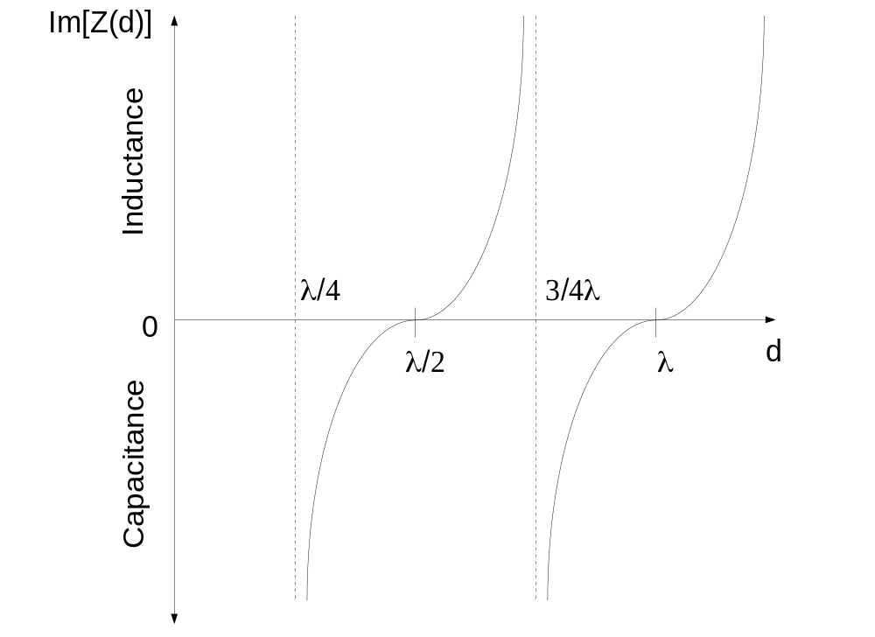
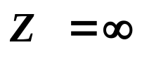
IIT Bombay
Page 6
Impedance of a Shorted Transmission Line
The input impedance alternates between shorts (Z=0)
and opens ( )
The short is transformed into an open for d=λ/4
EE 611 Lecture 1
EE 611 Jayanta Mukherjee Lecture 1
EE 611 Lecture 3 Jayanta Mukherjee

Slide 7
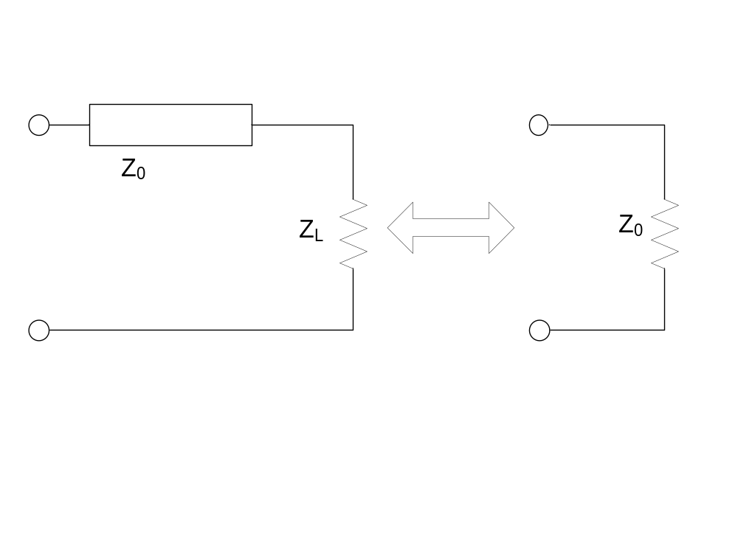
IIT Bombay
Page 7
Matched Line
When Z_{L}=Z₀ , the load is said to be matched
EE 611 Lecture 1
EE 611 Jayanta Mukherjee Lecture 1
EE 611 Lecture 4 Jayanta Mukherjee

Slide 8
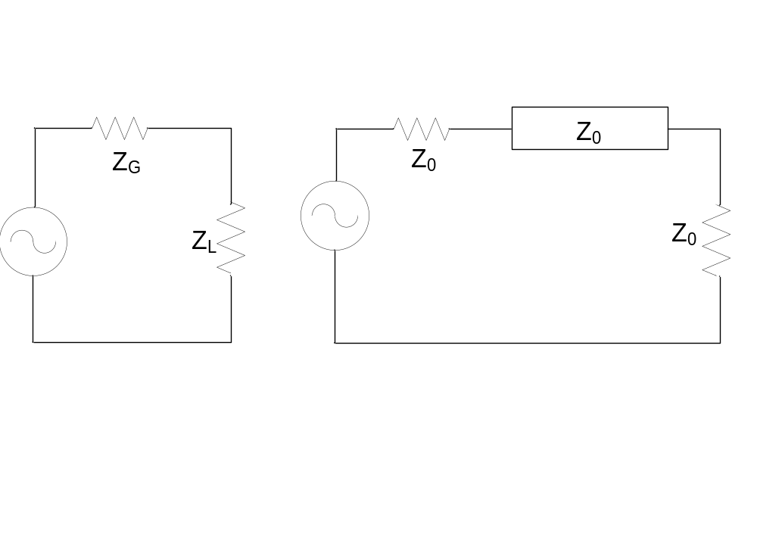
IIT Bombay
Page 8
Impedance Matching vs Conjugate
Impedance Matching
Impedance matching should be distinguished from conjugate
impedance matching Z_{G}=Z_{L}*used for maximum power transfer
Both load matching and conjugate impedance matching can
happen when Z_{G} = Z_{L}*= Z₀
EE 611 Lecture 1
EE 611 Jayanta Mukherjee Lecture 1
EE 611 Lecture 4 Jayanta Mukherjee

Slide 9
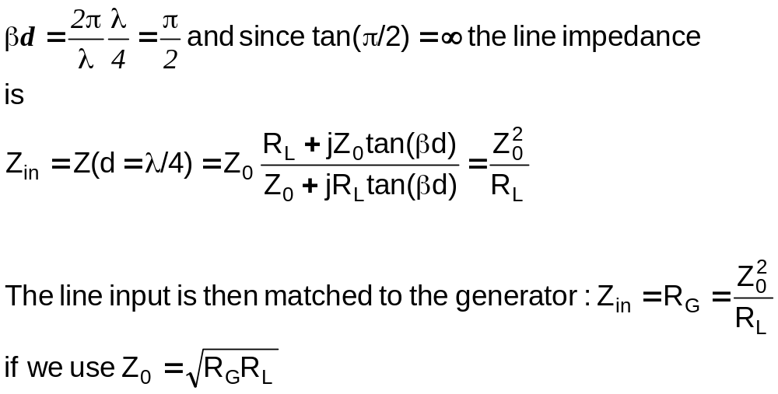
IIT Bombay
Page 9
Quarter Wave Transformer for a Resistive
Load R_{L}
For a line of one quarter of a wavelength (d=λ/4) we have
EE 611 Lecture 1
EE 611 Jayanta Mukherjee Lecture 1
EE 611 Lecture 4 Jayanta Mukherjee

Slide 10
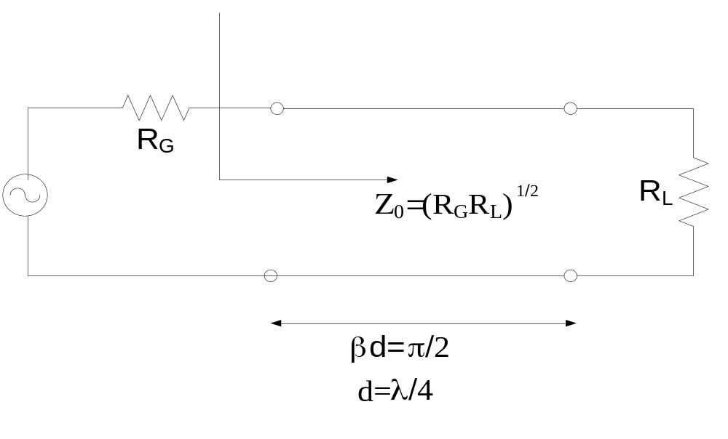
IIT Bombay
Page 10
Quarter Wave Transformer for a Resistive
Load R_{L}
The impedance matching is only realized at the frequency
where the transmission line length is quarter wavelength
EE 611 Lecture 1
EE 611 Jayanta Mukherjee Lecture 1
EE 611 Lecture 4 Jayanta Mukherjee

Slide 11
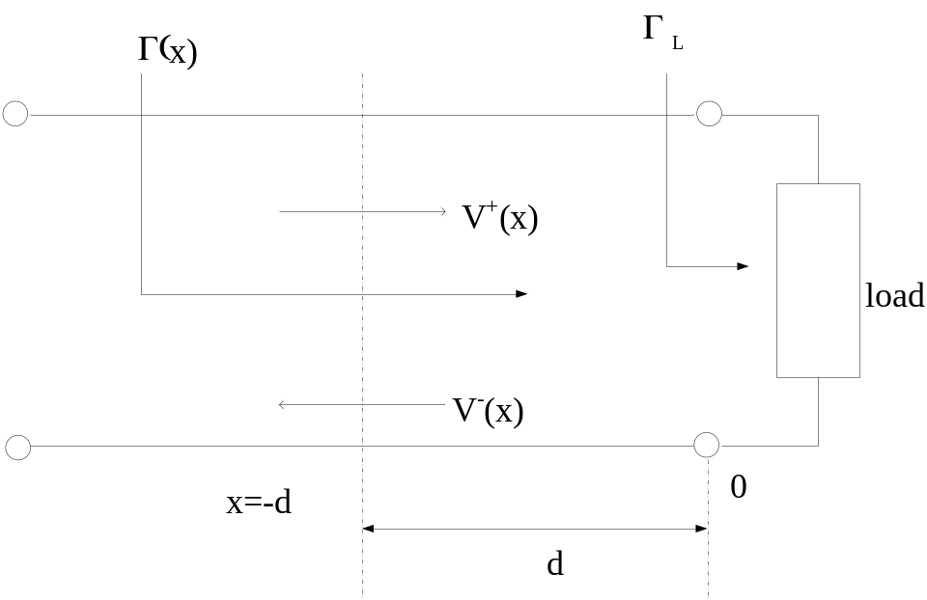
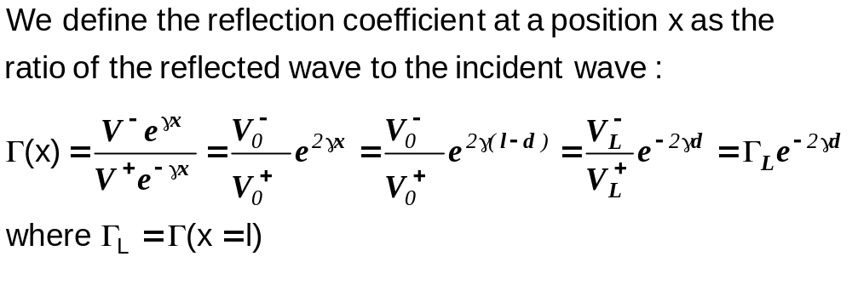
IIT Bombay
Page 11
Reflection Coefficient
EE 611 Lecture 1
EE 611 Jayanta Mukherjee Lecture 1
EE 611 Lecture 4 Jayanta Mukherjee

Slide 12
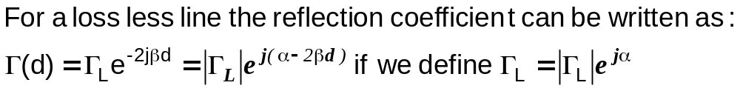
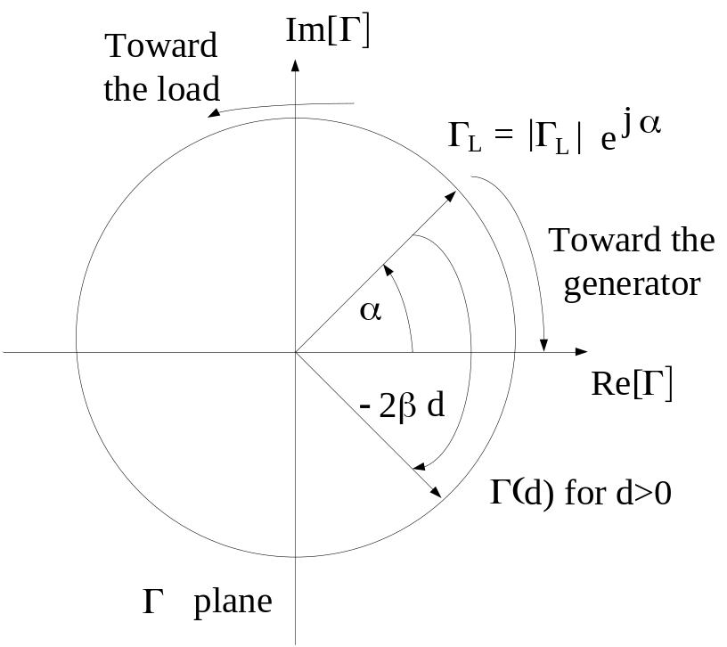
IIT Bombay
Page 12
Reflection Coefficient Along a Line
EE 611 Lecture 1
EE 611 Jayanta Mukherjee Lecture 1
EE 611 Lecture 4 Jayanta Mukherjee

Slide 13
IIT Bombay
Page 14
Reflection Coefficient Along a Line
As we move along the line, Γ(d) moves along a circle of radius
|Γ_{L}|
The reflection coefficient Γ(d) rotates clock wise as d increases
and we move towards the generator
EE 611 Lecture 1
EE 611 Jayanta Mukherjee Lecture 1
EE 611 Lecture 4 Jayanta Mukherjee

Slide 14
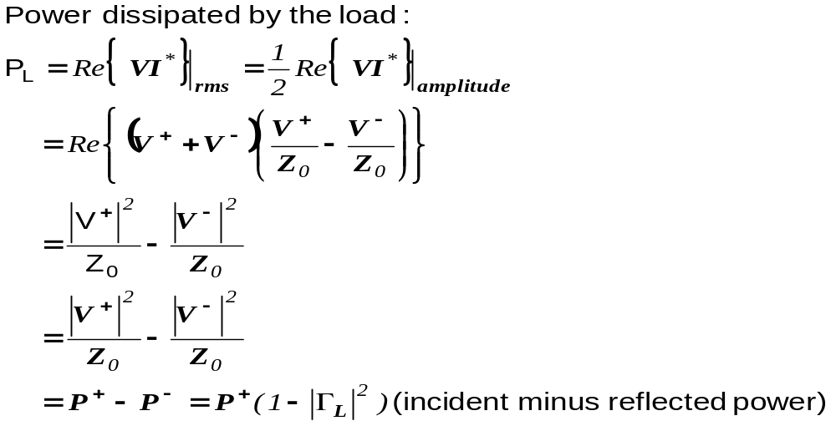
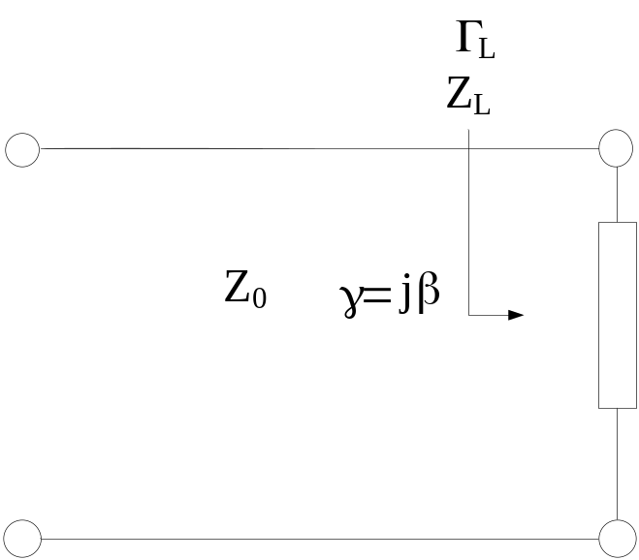
IIT Bombay
Page 15
Power Dissipated at the Load
EE 611 Lecture 1
EE 611 Jayanta Mukherjee Lecture 1
EE 611 Lecture 4 Jayanta Mukherjee

Slide 15
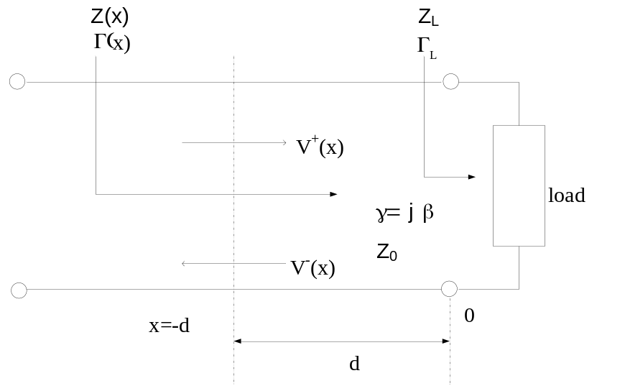
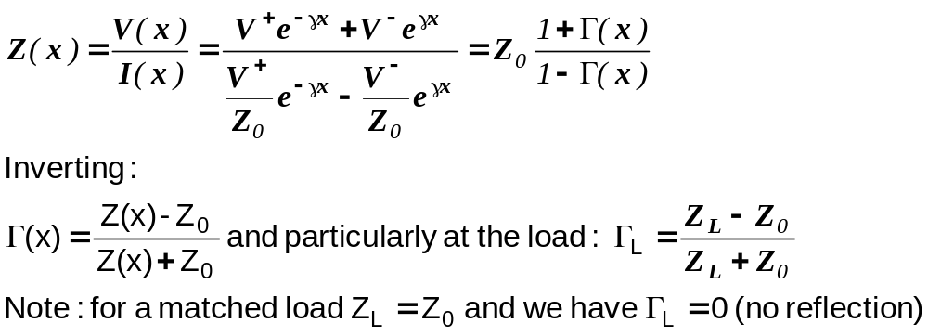
IIT Bombay
Page 16
Relation between impedance and Reflection
Coefficient
EE 611 Lecture 1
EE 611 Jayanta Mukherjee Lecture 1
EE 611 Lecture 4 Jayanta Mukherjee

Slide 16
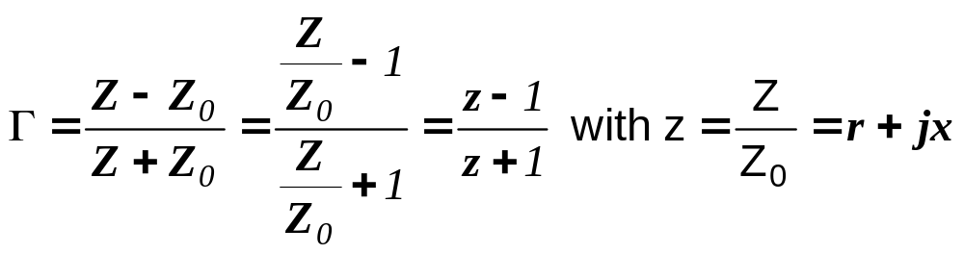
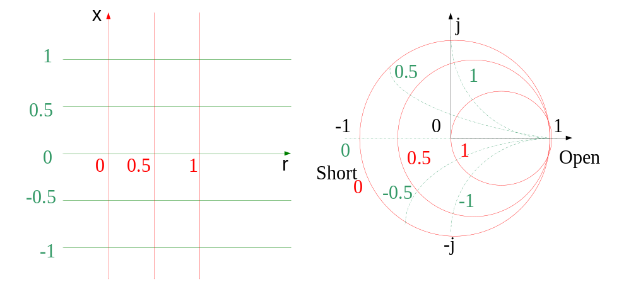
IIT Bombay
Page 17
The Smith Chart
Bilateral Transform connecting the impedance Z and the
Reflection coefficient Γ . The smith chart maps the x-plane on the
Γ plane
EE 611 Lecture 1
EE 611 Jayanta Mukherjee Lecture 1
EE 611 Lecture 4 Jayanta Mukherjee

Slide 17
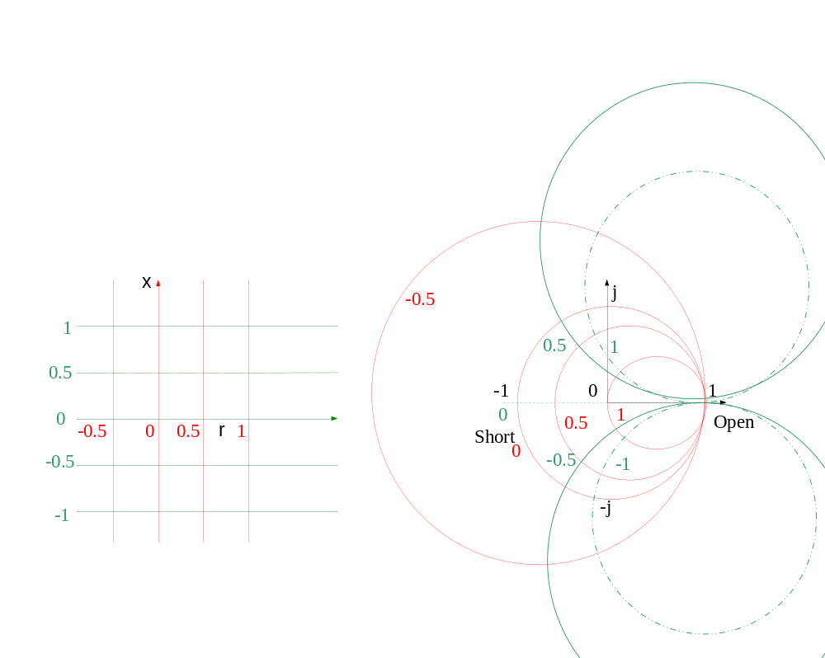
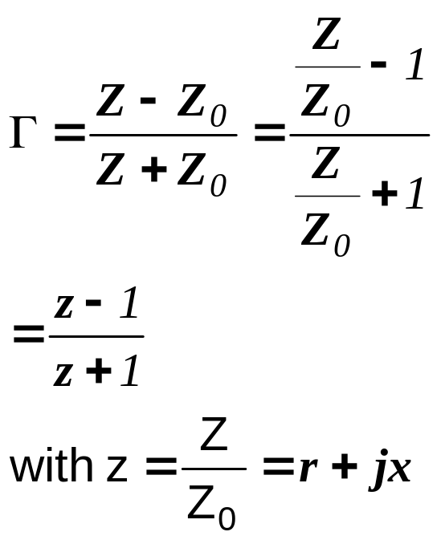
IIT Bombay
Page 18
Extended Smith Chart
For negative resistance r<0 we have |Γ|>1
For r=-1 (Re{Z}=-50 ohms) we have Γ=infinity
EE 611 Lecture 1
EE 611 Jayanta Mukherjee Lecture 1
EE 611 Lecture 4 Jayanta Mukherjee

Slide 18
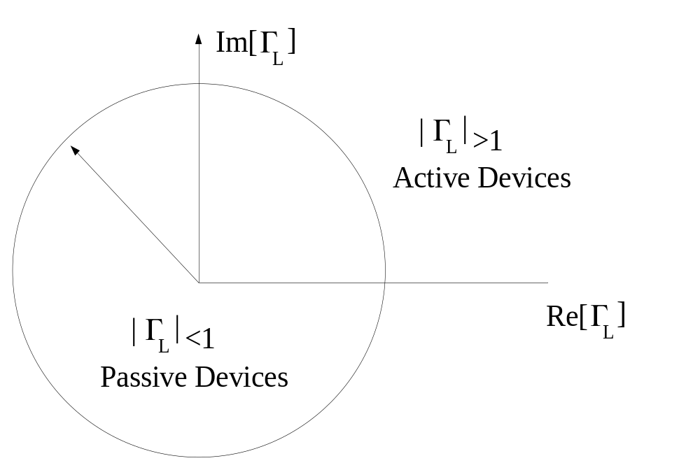
IIT Bombay
Page 19
Active and Passive Load
EE 611 Lecture 1
EE 611 Jayanta Mukherjee Lecture 1
EE 611 Lecture 4 Jayanta Mukherjee

Slide 19
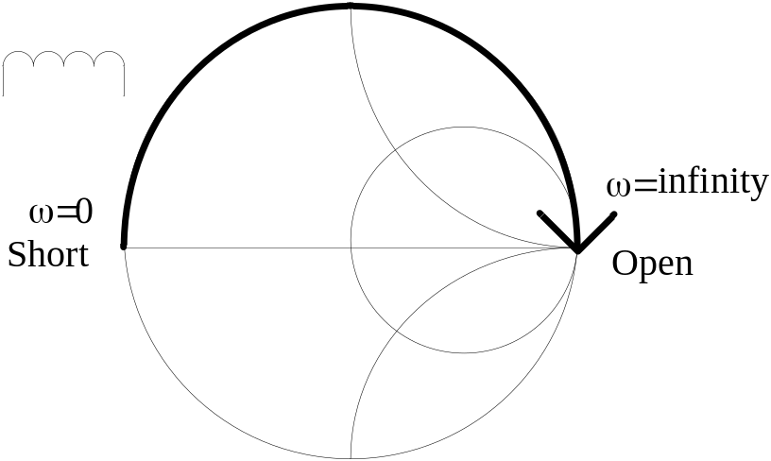
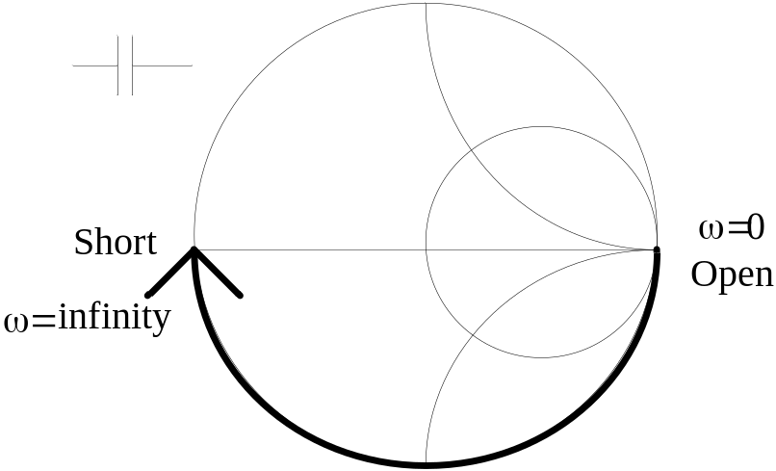
IIT Bombay
Page 20
Inductance and Capacitance on Smith Chart
Locus of the reflection coefficient for an inductor and a capacitor
In a Z Smith chart
Γ plane
Z smith chart
EE 611 Lecture 1
EE 611 Jayanta Mukherjee Lecture 1
EE 611 Lecture 4 Jayanta Mukherjee

Slide 20
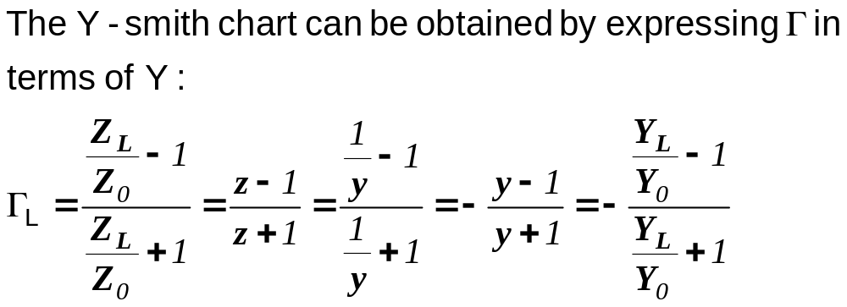
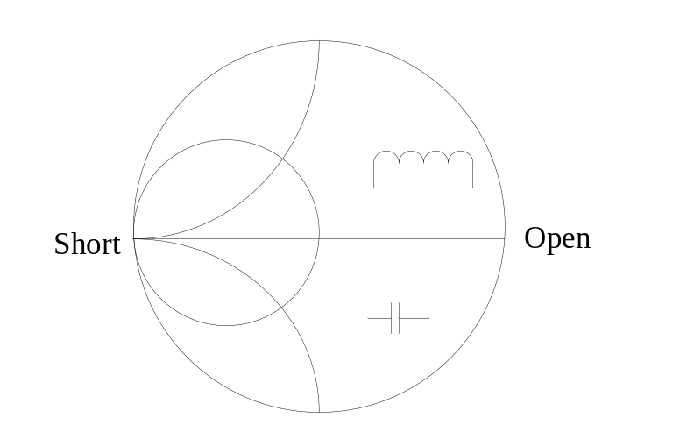
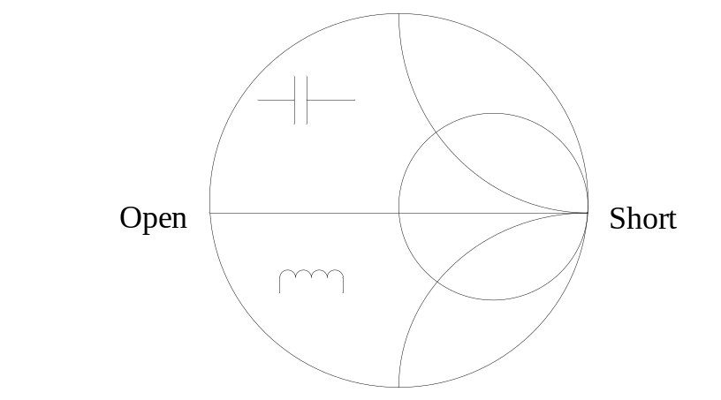
IIT Bombay
Page 21
Y Smith Chart
Γ plane
-Γ plane
Normal
Rotated
EE 611 Lecture 1
EE 611 Jayanta Mukherjee Lecture 1
EE 611 Lecture 4 Jayanta Mukherjee

Slide 21
IIT Bombay
Page 22
Y Smith Chart
The Y Smith Chart is obtained by inverting the Z smith chart
In the rotated Y-Smith Chart the short and open are exchanged
EE 611 Lecture 1
EE 611 Jayanta Mukherjee Lecture 1
EE 611 Lecture 4 Jayanta Mukherjee

Slide 22
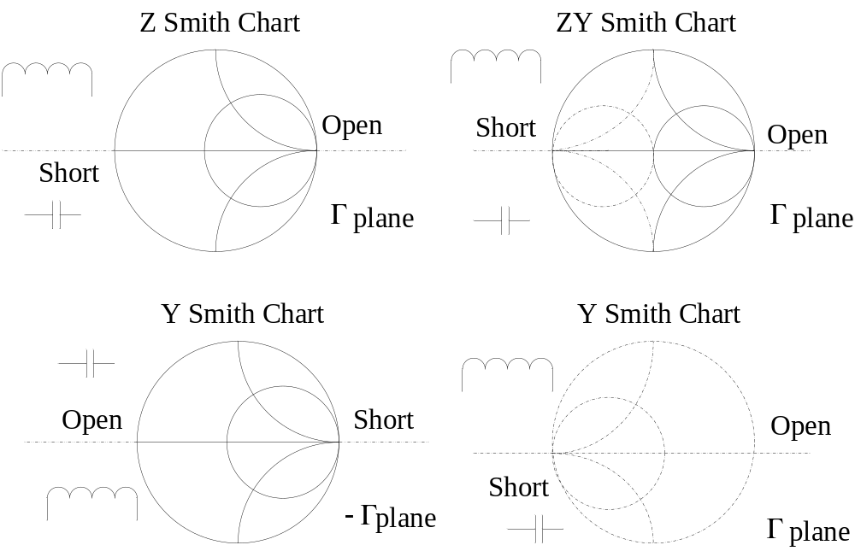
IIT Bombay
Page 23
Impedance and Admittance Smith Charts
EE 611 Lecture 1
EE 611 Jayanta Mukherjee Lecture 1
EE 611 Lecture 4 Jayanta Mukherjee

Slide 23
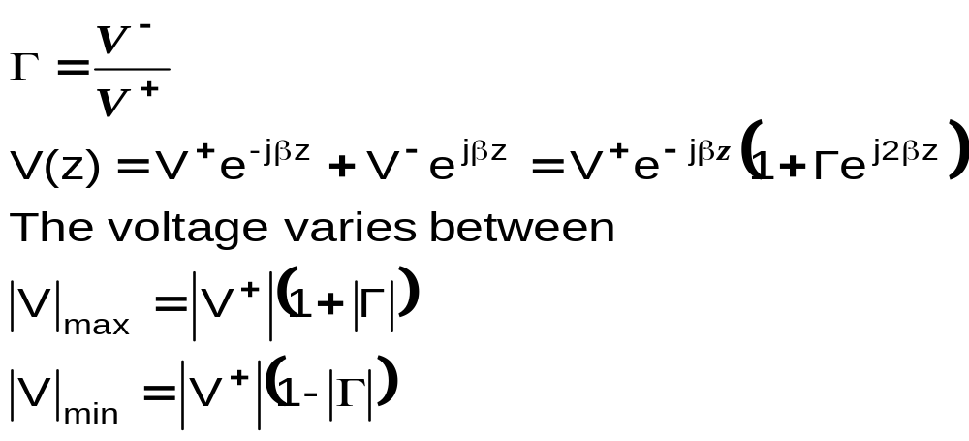
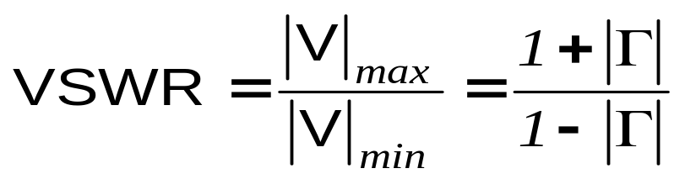
IIT Bombay
Page 24
Voltage Standing Wave Ratio (VSWR)
The voltage wave inside a transmission line can be written using
The voltage standing wave ratio (VSWR) is defined as:
EE 611 Lecture 1
EE 611 Jayanta Mukherjee Lecture 1
EE 611 Lecture 4 Jayanta Mukherjee

Slide 24
IIT Bombay
Page 25
Voltage Standing Wave Ratio (VSWR)
A perfect matching (|Γ|=0) corresponds to VSWR of 1
VSWR should be less than 2
EE 611 Lecture 1
EE 611 Jayanta Mukherjee Lecture 1
EE 611 Lecture 4 Jayanta Mukherjee

Slide 25
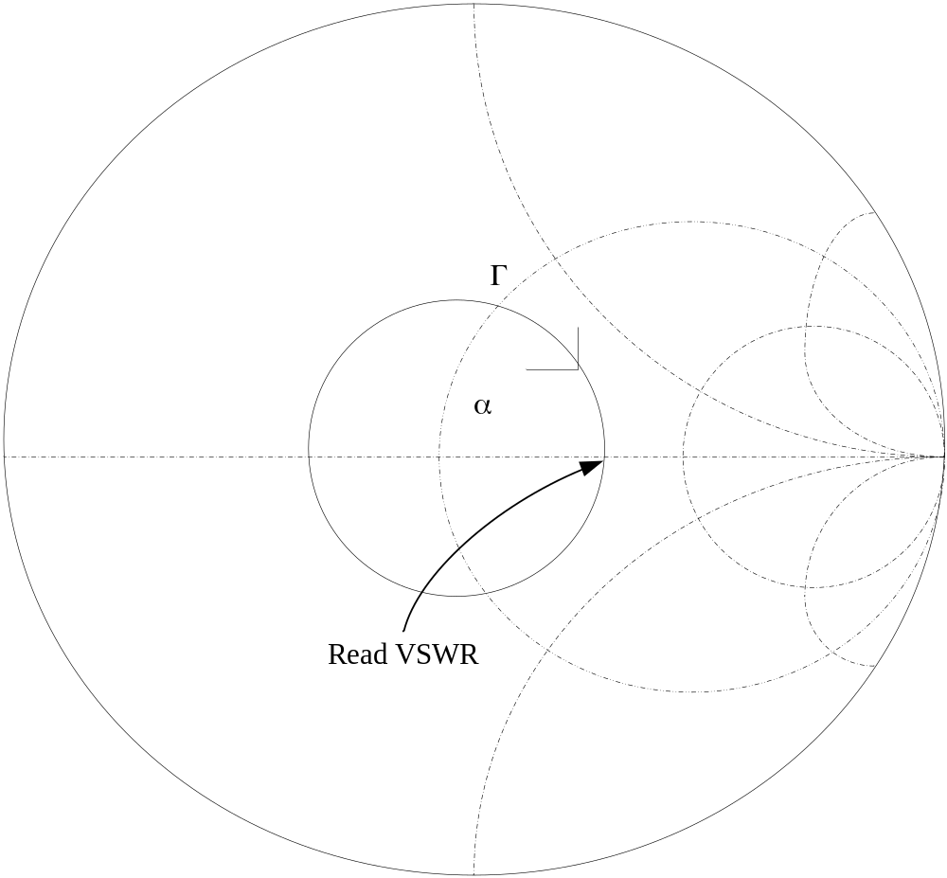
IIT Bombay
Page 26
Calculation of VSWR with Smith Chart
EE 611 Lecture 1
EE 611 Jayanta Mukherjee Lecture 1
EE 611 Lecture 4 Jayanta Mukherjee

